Slide 1
Unit 2
ER Modeling

Slide 2
Database Design Techniques
Top down Approach
Top down starts by defining the data sets and then define the data elements within those sets. As a result of this method, you generally end up with redundant information in one or more tables.
Some references call this Entity - Relationship modeling.
Bottom Up approach
Bottom up starts by defining the required attributes and then grouping them to form the entities. Another term used for this method is normalization from functional dependencies.

Slide 3
ER Modeling Top down Approach

Slide 4
ER modeling
ER modeling: A graphical technique for understanding and organizing the data independent of the actual database implementation.
Entity: Any thing that may have an independent existence and about which we intend to collect data.
Also known as Entity type. E.g.: Trainee
Relationships: Associations between entities. E.g.: Trainee belongs to a Batch
Attributes: Properties/characteristics that describe entities.eg: Trainee Name, BatchName, DOB, Address, etc.

Slide 5
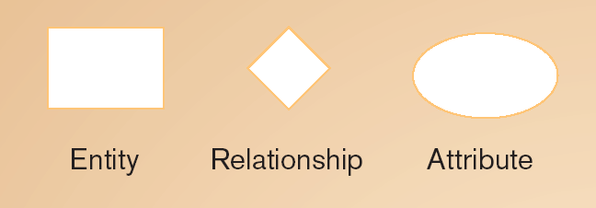

Association between the instances of one or more entity types
EntityName
Verb Phrase
AttributeName
Person, place, object, event or concept about which data is to be maintained
named property or characteristic of an entity
Represents a set or collection of objects in the real world that share the same properties

Slide 6
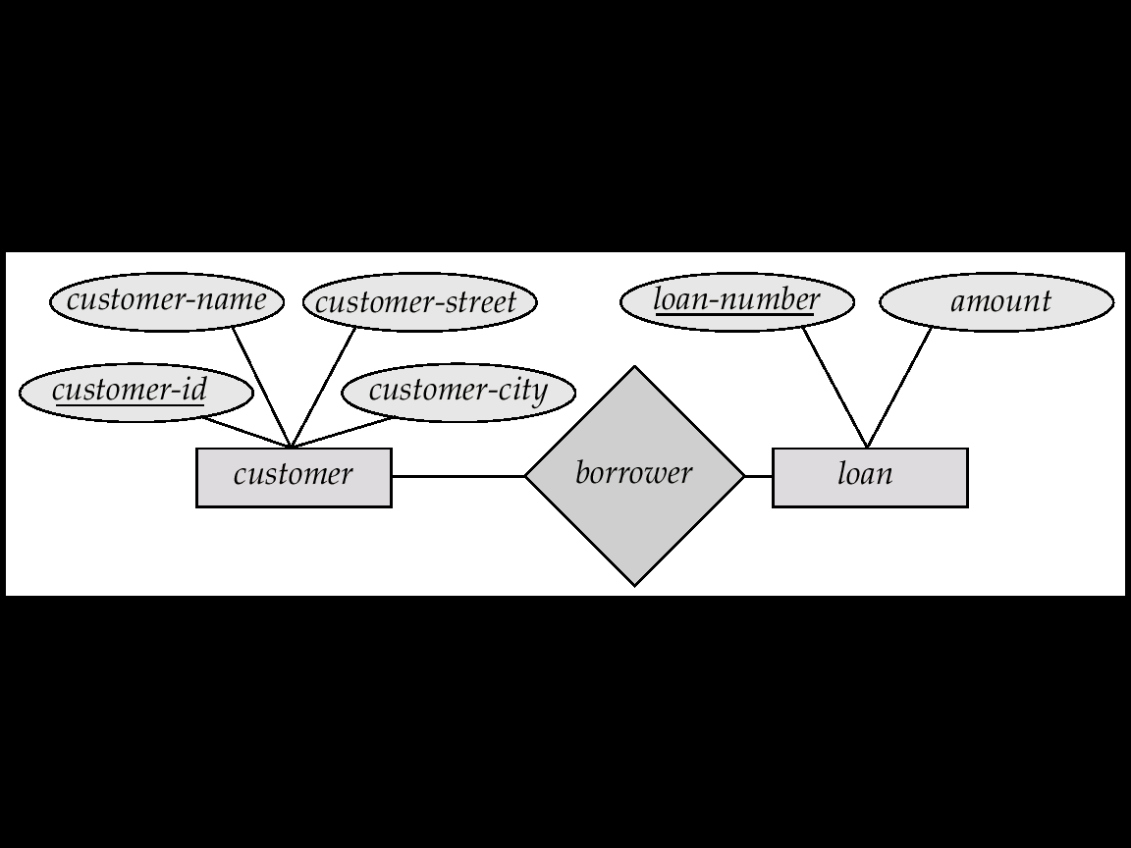
An Example

Slide 7
Entities
An entity is a thing in a real-world with independent existence. An entity can exist independently and is distinguishable from other objects.
An Entity is an object of Entity Type and set of all entities is called as entity set. e.g.; E1 is an entity having Entity Type Student and set of all students is called Entity Set.
Examples of entities:
Person: EMPLOYEE, STUDENT, PATIENT
Place: STORE, WAREHOUSE
Object: MACHINE, PRODUCT, CAR
Event: SALE,REGISTRATION, RENEWAL
Concept: ACCOUNT, COURSE

Slide 8
Entity Types
Regular Entity : Entity that has its own key attribute (s). Strong entity
E.g.: Employee, student ,customer, policy holder etc.
Weak entity: Entity that depends on other entity for its existence and doesn’t have key attribute (s) of its own
E.g. : Kids of employee

Slide 9
Attributes
The set of possible values for an attribute is called the domain of the attribute
Example:
The domain of attribute marital status is having four values: single, married, divorced or widowed.
The domain of the attribute month is having twelve values ranging from January to December.
Key attribute: The attribute (or combination of attributes) that is unique for every entity instance
E.g.: the account number of an account, the employee id of an employee etc.
Notes:
Key attribute mentioned in the slide should not be miss understood with key attribute discussion of relational model. The key attribute discussion here is only in the context of ER Diagram.

Slide 10

Attribute Type
Types of Attributes | Definition | Example
Simple attribute | Cannot be divided into simpler components | Gender of the employee
Composite attribute | Can be split into components | Date of joining of the employee
Single valued | Can take on only a single value for each entity instance | Age of the employee
Multi-valued | Can take up many values | Skill set of the employee
Stored Attribute | Attribute that need to be stored permanently | Date of joining of the employee
Derived Attribute | Attribute that can be calculated based on other attributes. | Years of service of the employee

Slide 11
Degree of a Relationship
Degree: the number of entity types involved
One Unary
Two Binary
Three Ternary
E.g.: employee manager-of employee is unary
employee works-for department is binary
customer purchase item, shop keeper is a ternary relationship

Slide 12
Cardinality Ratios
In ER model, a relationship is an association among entities (records) of one or more entity sets. Cardinality ratio or mapping cardinalities is a concept that describes binary relationship set (a relationship that connects two entity sets) and its types.
It is about the maximum number of entities of one entity set that are associated with the maximum number of entities of the other entity set.

Slide 13
Cardinality
Relationships can have different connectivity
one-to-one (1:1)
one-to-many (1:N)
many-to- One (M:1)
many-to-many (M:N)
E.g.:
Employee head-of department (1:1)
Lecturer offers course (1:N) assuming a course is taught by a single lecturer
Student enrolls course (M:N)
The minimum and maximum values of this connectivity is called the cardinality of the relationship
Notes:
The minimum and maximum values of this connectivity is called the cardinality of the relationship

Slide 14
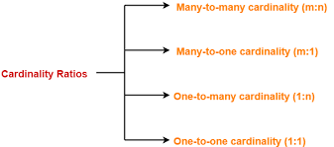

Slide 15
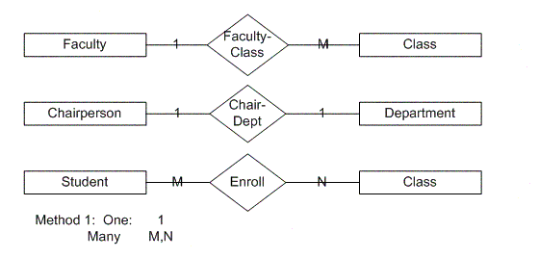

Slide 16
Participation constraints in DBMS
This constraint specifies the number of instances of an entity that are participating in the relationship type.
There are two types of Participation constraint:
Total participation
Partial participation

Slide 17
Total participation constraint
It specifies that each entity present in the entity set must mandatorily participate in at least one relationship instance of that relationship set,for this reason, it is also called as mandatory participation.
It is represented using a double line between the entity set and relationship set.
Example of total participation constraint
It specifies that each student must be enrolled in at least one course where the “student” is the entity set and relationship “enrolled in” signifies total participation
It means that every student must have enrolled at least in one course

Slide 18
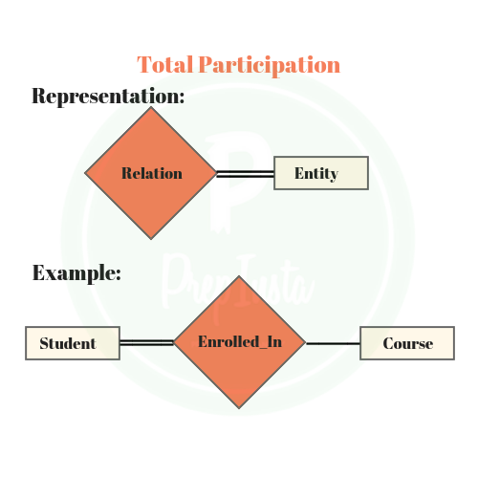
Example of total participation constraint

Slide 19
Partial participation
It specifies that each entity in the entity set may or may not participate in the relationship instance of the relationship set, is also called as optional participation
It is represented using a single line between the entity set and relationship set in the ER diagram
Example of partial participation
A single line between the entities i.e courses and enrolled in a relationship signifies the partial participation,which means there might be some courses where enrollments are not made i.e enrollments are optional in that case

Slide 20

Example of partial participation

Slide 21
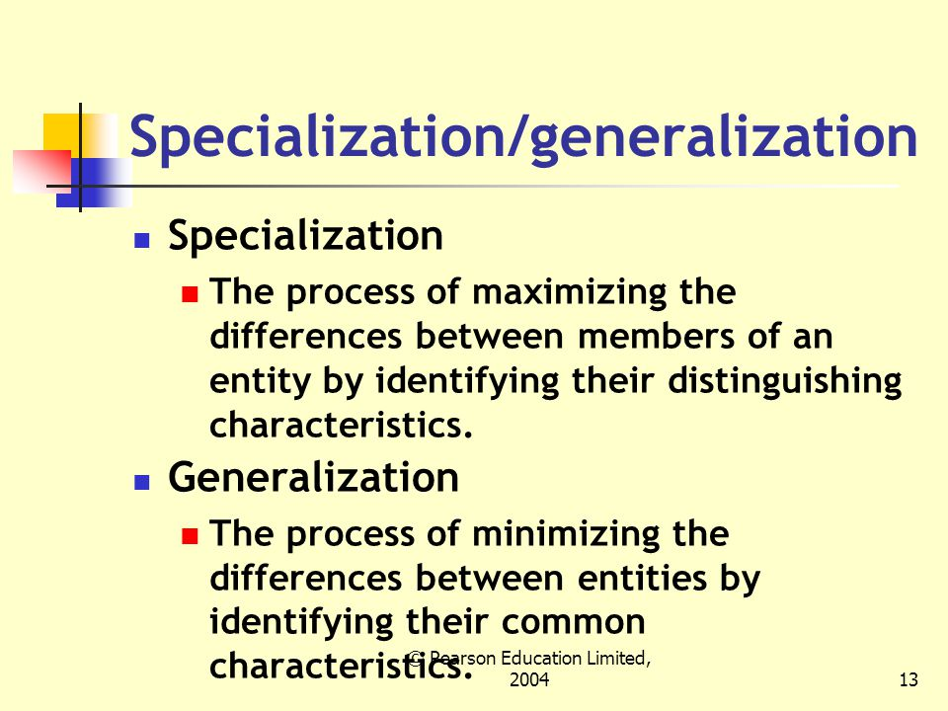

Slide 22
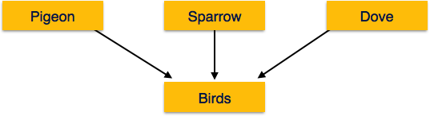
Generalization

Slide 23
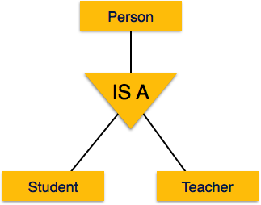
Specialization

Slide 24
Degree of Relationship
Degree of relationship refers to the number of participating entities in a relationship. If there are two entities involved in relationship, then it is referred to as binary relationship. If there are three entities involved, then it is called as ternary relationship and so on.
Following are the degrees of Relationships.
1. Single Entity - Unary
2. Double Entities - Binary
3. Triple Entities - Ternary
4. N Entities - N- ary

Slide 25
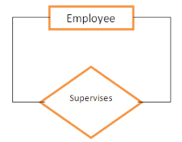
Unary

Slide 26
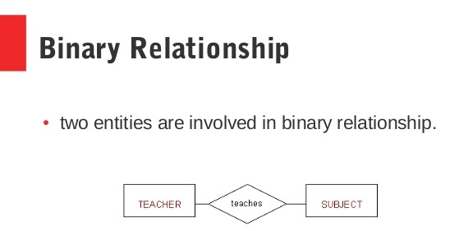

Slide 27
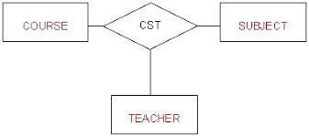
Ternary

Slide 28

ER Modeling - Notations

Slide 29
ER Modeling -Notations
 | An Entity is an object or concept about which business user wants to store information.
 | A weak Entity is dependent on another Entity to exist. Example Order Item depends upon Order Number for its existence. Without Order Number it is impossible to identify Order Item uniquely.
 | Attributes are the properties or characteristics of an Entity
 | A key attribute is the unique, distinguishing characteristic of the Entity
 | A multi-valued attribute can have more than one value. For example, an employee Entity can have multiple skill values.

Slide 30
ER Modeling -Notations
 | A derived attribute is based on another attribute. For example, an employee's monthly salary is based on the employee's basic salary and House rent allowance.
 | Relationships illustrate how two entities share information in the database structure.
 | To connect a weak Entity with others, you should use a weak relationship notation.

Slide 31
ER Modeling -Notations
Customer
 | Cardinality specifies how many instances of an Entity relate to one instance of another Entity. M,N both represent ‘MANY’ and 1 represents ‘ONE’ Cardinality
1
N
1
M
Account
Transaction
 | In some cases, entities can be self-linked. For example, employees can supervise other employees

Slide 32
Composite attribute
floor
building
DOB
Name
Address
E#
Designation
Employee
Represented by an ellipse from which other ellipses emanate and represent the component attributes. E.g Address
Notes:
Represented by an ellipse from which other ellipses emanate and represent the component attributes. E.g Address

Slide 33
Unary Relationship
Manages
Employee
A unary relationship is represented as a diamond which connects one entity to itself as a loop.
The relationship above means, some instances of employee manage other instances of Employee.
Notes:
A unary relationship is represented as a diamond which connects one entity to itself as a loop.
The relationship above means, some instances of employee manage other instances of Employee.

Slide 34
Role names
Role names may be added to make the meaning more explicit
subordinate
Manages
Employee
Manager

Slide 35
Binary Relationship
Employee
Works
for
Department
Notes:
A relationship between two entity types

Slide 36
Ternary Relationship
Medicine
Doctor
Prescription
Patient
Notes:
A relationship connecting three entity types.

Slide 37
Relationship participation
1
head
of
1
Employee
department
Total
partial
Notes:
All instances of the entity type Employee don’t participate in the relationship, Head-of.
Every employee doesn’t head a department. So, employee entity type is said to partially participate in the relationship.
But, every department would be headed by some employee.
So, all instances of the entity type Department participate in this relationship. So, we say that it is total participation from the department side.

Slide 38
since
since
name
name
dname
dname
ssn
did
did
budget
lot
budget
Employees
1
1
Departments
Manages
M
Works_In
1
since

Slide 39
Attributes of a Relationship
Medicine
Number of days
dosage
Doctor
Prescription
Patient
These attributes best describe the relationship prescription rather than any individual entity Doctor, Patient or Medicine.
Notes:
These attributes best describe the relationship prescription rather than any individual entity Doctor, Patient or Medicine.

Slide 40
Weak entity
E#
Id
----
name
1
has
N
dependant
Employee
The dependant entity is represented by a double lined rectangle and the identifying relationship by a double lined diamond
Notes:
The identifying relationship is the one which relates the weak entity (dependent) with the strong entity (Employee) on which it depends.
Id is underlined with a dotted line because it is used to form composite key of dependent entity along with E#.

Slide 41
Case Study – ER Model For a college DB
Assumptions :
A college contains many departments
Each department can offer any number of courses
Many instructors can work in a department
An instructor can work only in one department
For each department there is a Head
An instructor can be head of only one department
Each instructor can take any number of courses
A course can be taken by only one instructor
A student can enroll for any number of courses
Each course can have any number of students

Slide 42
Steps in ER Modeling
Identify the Entities
Find relationships
Identify the key attributes for every Entity
Identify other relevant attributes
Draw complete E-R diagram with all attributes including Primary Key
Review your results with your Business users
Visit the following link for more information
10 Easy Steps to Create an ER Diagram in VISIO 2000

Slide 43
Steps in ER Modeling
Step 1: Identify the Entities
DEPARTMENT
STUDENT
COURSE
INSTRUCTOR

Slide 44
Steps in ER Modeling
Step 2: Find the relationships
One course is enrolled by multiple students and one student enrolls for multiple courses, hence the cardinality between course and student is Many to Many.
The department offers many courses and each course belongs to only one department, hence the cardinality between department and course is One to Many.
One department has multiple instructors and one instructor belongs to one and only one department , hence the cardinality between department and instructor is one to Many.
Each department there is a “Head of department” and one instructor is “Head of department “,hence the cardinality is one to one .
One course is taught by only one instructor, but the instructor teaches many courses, hence the cardinality between course and instructor is many to one.

Slide 45
Steps in ER Modeling
Step 3: Identify the key attributes
Deptname is the key attribute for the Entity “Department”, as it identifies the
Department uniquely.
Course# (CourseId) is the key attribute for “Course” Entity.
Student# (Student Number) is the key attribute for “Student” Entity.
Instructor Name is the key attribute for “Instructor” Entity.
Step 4: Identify other relevant attributes
For the department entity, the relevant attribute is location
For course entity, course name,duration,prerequisite
For instructor entity, room#, telephone#
For student entity, student name, date of birth

Slide 46
Entities
DEPARTMENT NAME
LOCATION
DEPARTMENT
STUDENT
STUDENT#
STUDENT NAME
DATE OF BIRTH

Slide 47
COURSE
PRE REQUISITE
COURSE#
COURSE NAME
DURATION
INSTRUCTOR
INSTRUCTOR NAME
TELEPHONE#
ROOM#

Slide 48
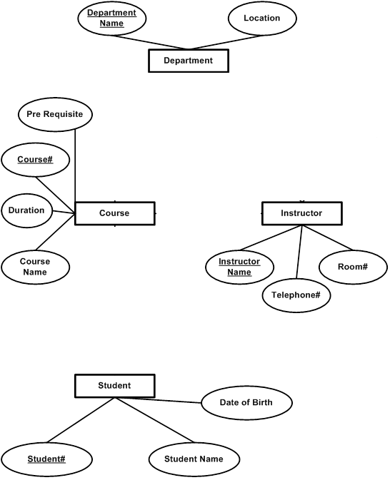

Slide 49
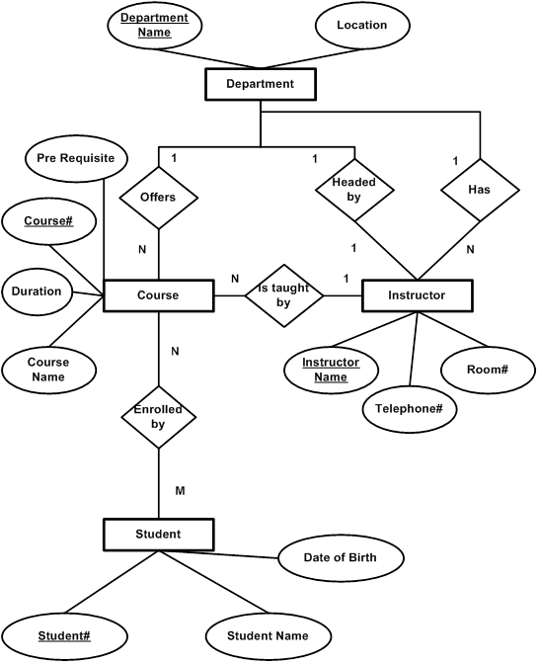

Slide 51
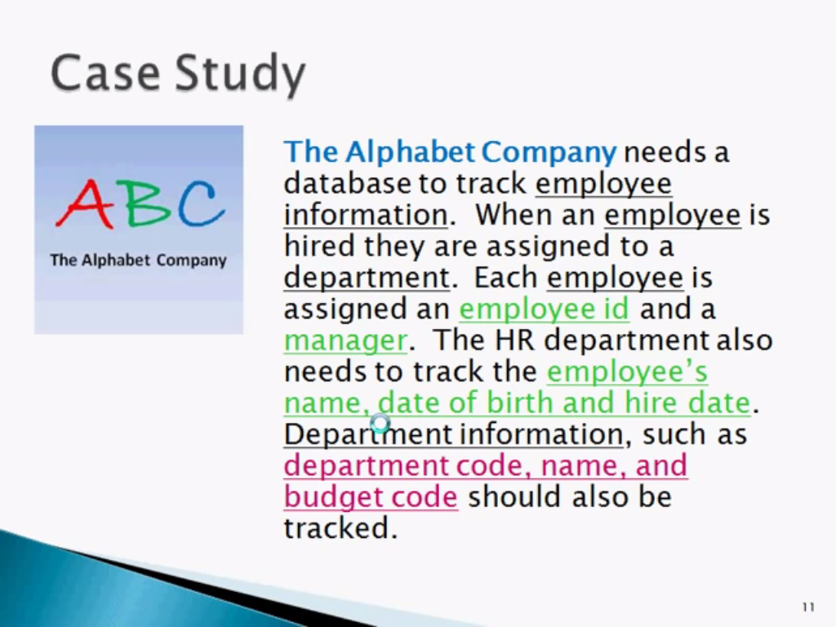

Slide 52
Specialization
A lower-level entity set inherits all the attributes and relationship participation of the higher-level entity set to which it is linked.
A lower-level entity set may have additional attributes and participate in additional relationships

Slide 53
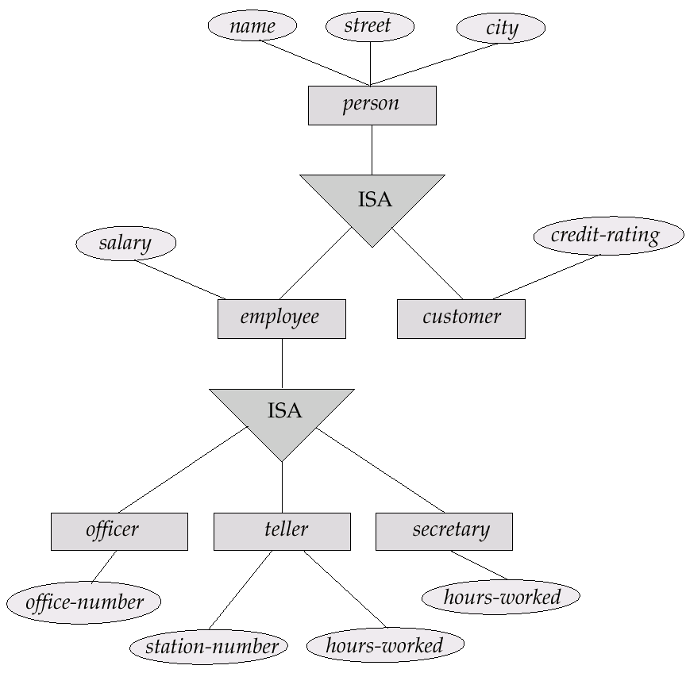

Slide 54
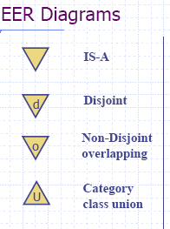

Specification
Disjoint/Overlapping
Completeness constraint
(use double lines)
total : an entity must belong to one of the lower-level entity sets
partial: an entity need not belong to one of the lower-level entity sets

Slide 55
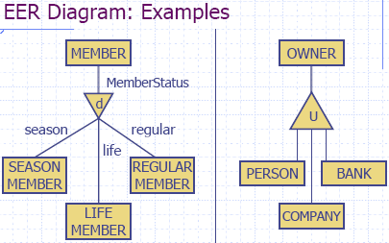
Category owner is the subclass of the set union of entity types person, company and bank

Slide 56
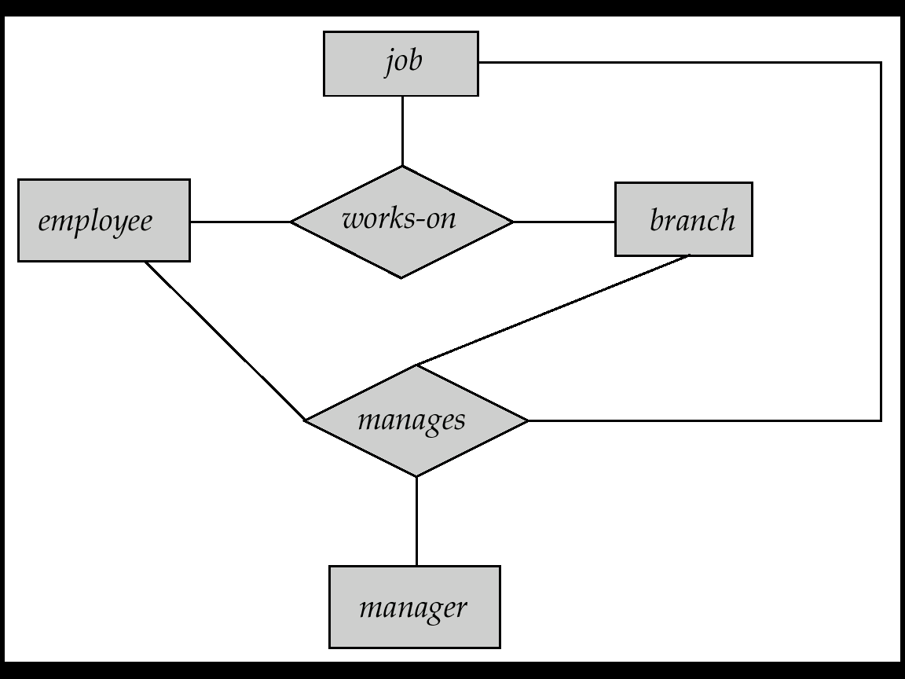
Aggregation
Consider the ternary relationship works-on, which we saw earlier
Suppose we want to record managers for tasks performed by an employee at a branch

Slide 57
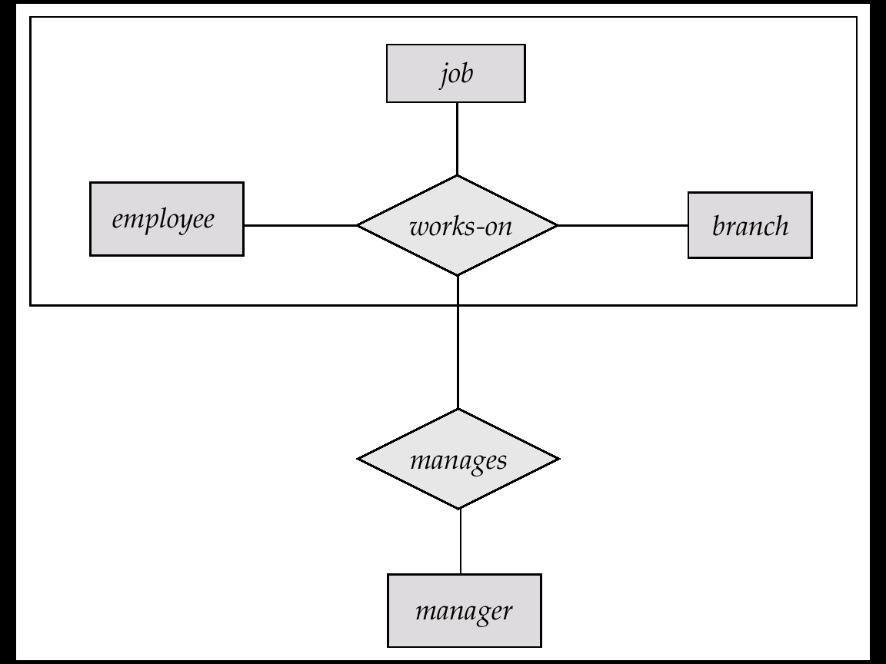
E-R Diagram With Aggregation

Slide 58
Design Considerations
Use of entity sets vs. attributes
Whether we want to keep additional information
Use of entity sets vs. relationship sets
Actions among entities are usually represented by relationships
Binary versus n-ary relationship sets
N-nary relationships are usually more natural for actions among entity sets
Weak entity set vs. strong entity set
Generalization

Slide 59
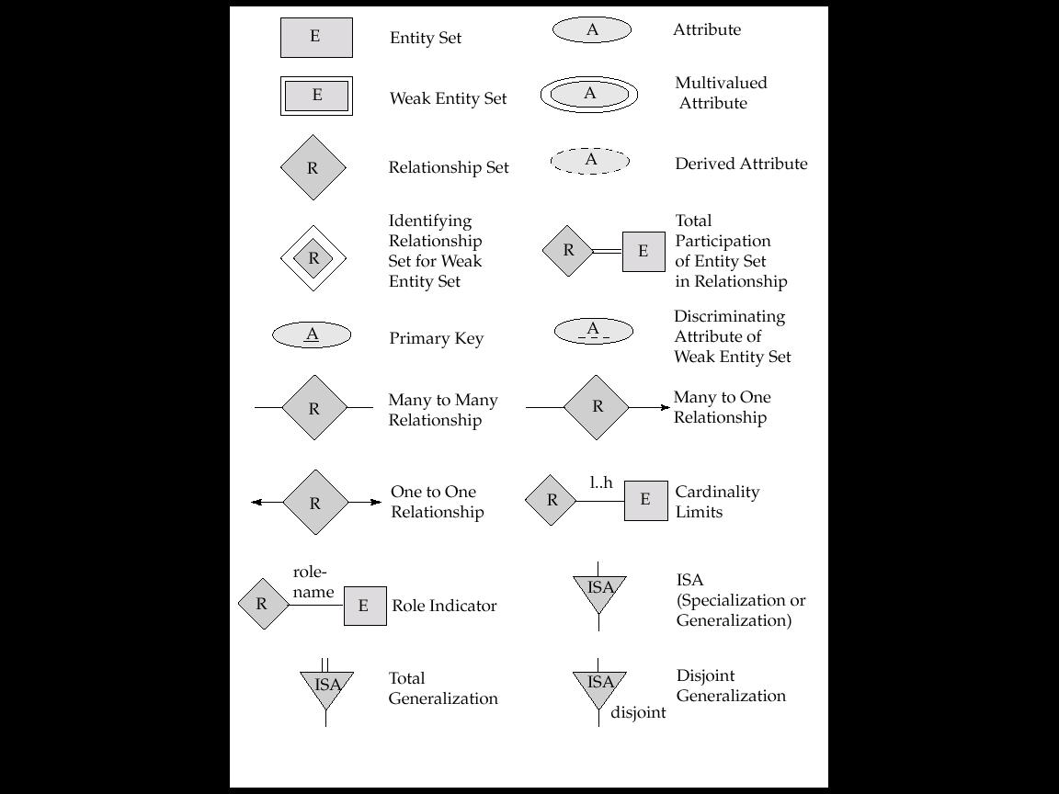
Notations

Slide 60

Notations

Slide 61
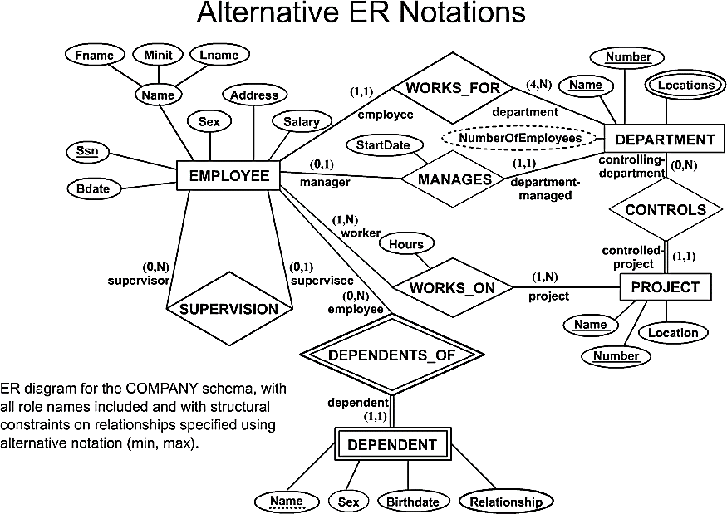
COMPANY ER Schema Diagram using (min, max) notation

Slide 62
Designing an ER Diagram
Consider the following set of requirements for a University database. Design an ER diagram for this application:
The university keeps track of each student's name, student number, social security number, current address and phone number, permanent address and phone number, birthdate, sex, class (freshman, graduate), major department, minor department (if any), degree program (B.A., B.S., ... Ph.D.). Some user applications need to refer to the city, state, and zip code of the student's permanent address and to the student's last name. Both social security number and student number are unique for each student. All students will have at least a major department.
Each department is described by a name, department code, office number, office phone, and college. Both the name and code have unique values for each department.
Each course has a course name, description, course number, number of credits, level and offering department. The course number is unique for each course.
Each section has an instructor, semester, year, course, and section number. The section number distinguishes sections of the same course that are taught during the same semester/year; its value is an integer (1, 2, 3, ... up to the number of sections taught during each semester).
A grade report must be generated for each student that lists the section, letter grade, and numeric grade (0,1,2,3, or 4) for each student and calculates his or her average GPA.

Slide 63
University ER Diagram
Degree
Major In
DName
DCode
OfficeNumber
Name
StudentID
SSN
Birth date
Department
OfficePhone
Sex
Student
Minor In
College
Class
Address
Offer
City
State
Zip
Grade_Report
CName
CourseDesc
Letter Grade
Instructor
Year
Course
GPA
CNumber
Belong_To
Credits
Numeric Grade
Section
SectionNumber
Semester

Slide 64
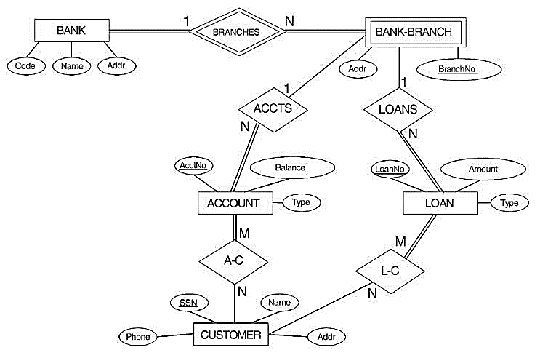
ER DIAGRAM FOR A BANK DATABASE

Slide 65
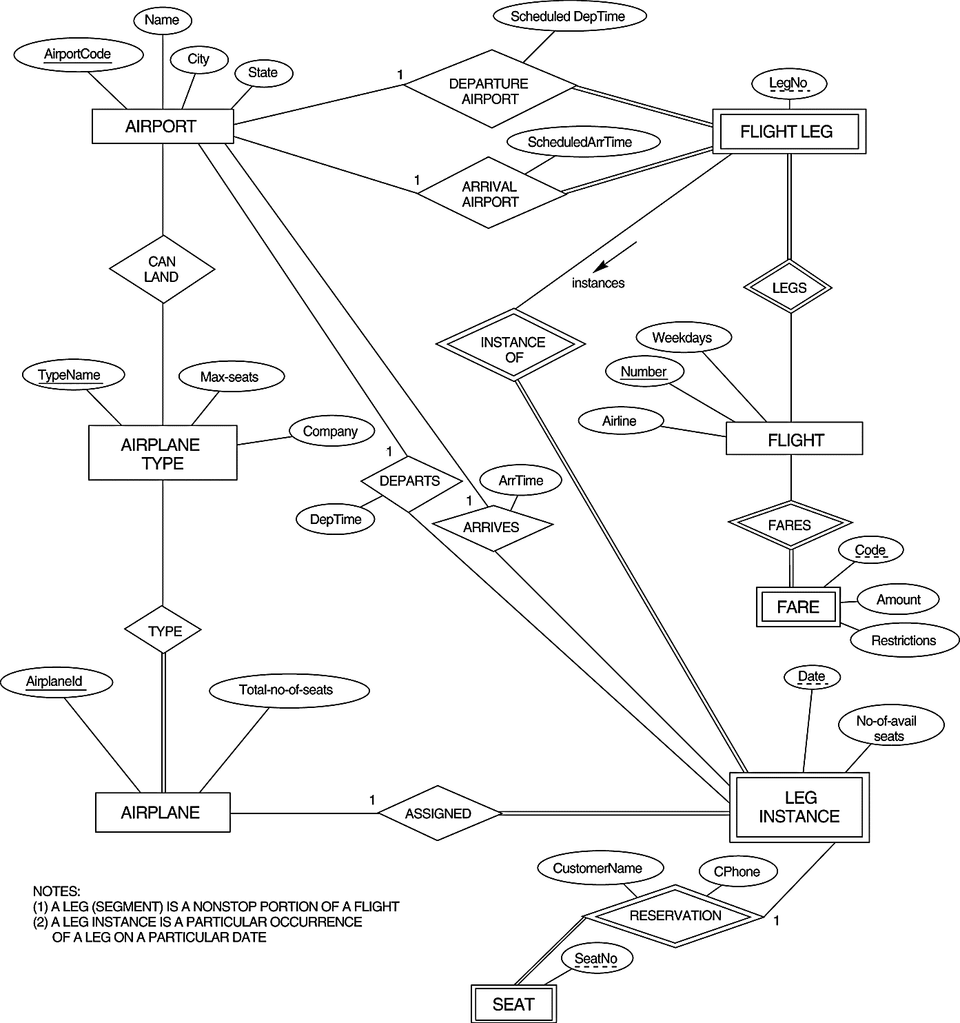
An ER diagram for an AIRLINE database schema.

Slide 66
Enhanced ER Model

Slide 67
Superclass/Subclass
Subclasses
Subgroupings of the entities of an entity type
An entity type as a superclass of subclasses
Examples
EMPLOYEE {SALARIED_EMPLOYEE, HOURLY_EMPLOYEE}
PATIENT {OUTPATIENT, INPATIENT}
STUDENT {FULL-TIME, PART-TIME}

Slide 68
Superclass/Subclass
“IS-A” relationship
Members of a subclass must be members of the superclass
A FULL-TIME STUDENT ISA STUDENT
Not every entity in a superclass be a member of a subclass
Subclasses
Should have meaningful subgroupings
Should be related to database applications

Slide 69
Entity Type Inheritance
Type Inheritance among Classes
Inherited Attributes
a subclass inherits the attributes of the superclass
HOURLY_EMPLOYEE (Name, SSN, Address)
Local (Specific) Attributes
a subclass may have its own attributes
HOURLY_EMPLOYEE (Hourly_rate)
SALARIED_EMPLOYEE (Annual_salary)

Slide 70
EER Example
Entity Type Inheritance

Slide 71
Specialization & Generalization
superclass-subclass relationship
Specialization: a means of identifying sub-groups within an entity set which have attributes which are not shared by all the entities (top-down)
Generalization: Multiple entity sets are synthesized into a higher level entity set based on common features (bottom-up)
E-R Symbol:
ISA

Slide 72
Specialization

Slide 73
Generalization

Slide 74
Inheritance
A lower-level entity set inherits all the attributes of the higher level entity sets
A subclass (lower level entity) also inherits participation in the relationship sets in which its superclass (higher-level entity) participates.
The outcome of specialization and generalization is the same: hierarchy of entity sets.

